Slide 1
Constraint-based modelling for the study of Polymicrobial Infections
Krushanu Patki (BE23B007)

Slide 2
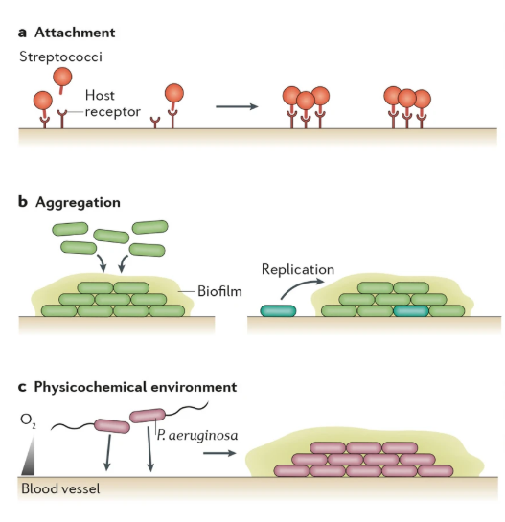
Motivation
GEMs have been used to study the integrated host-pathogen metabolic networks and the metabolism of pathogens during co-infections in culture media.
However, models that integrate a host metabolic network with those of multiple coinfecting pathogens in polymicrobial diseases have not been investigated.
Factors that determine a pathogen niche
(adapted from [1])

Slide 3
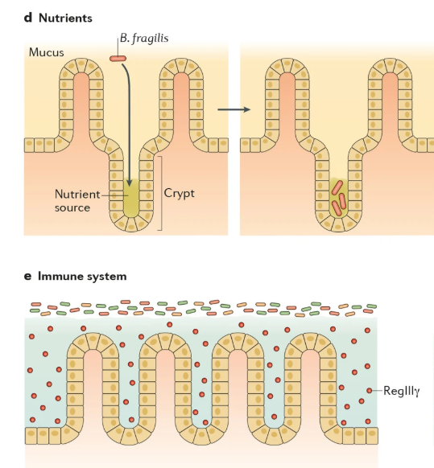
Objectives
Construct an integrated model of the metabolic networks of the small intestine epithelial cell, V. cholerae, and E. coli.
Define a suitable extracellular medium and objective function.
Validate the model using known experimental trends
Generate testable hypotheses about the pathology of polymicrobial diseases.
Factors that determine a pathogen niche
(adapted from [1])

Slide 4
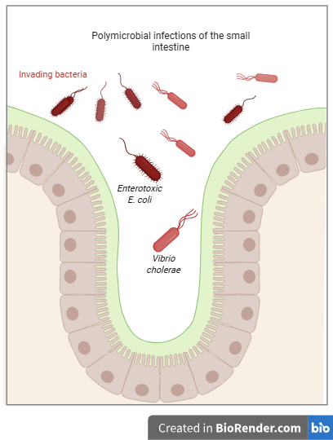
Construction of the Integrated Model
Unique labels for metabolites and reactions belonging to different cell types.
Create a shared pool of extracellular metabolites available to all cell types from the extracellular lumen.
Establish transport reactions between the shared pool and different cell types:
Shared pool on the apical side to the cytoplasm of enterocytes
Cytoplasm of enterocytes to the bloodstream on the basal side

Slide 5
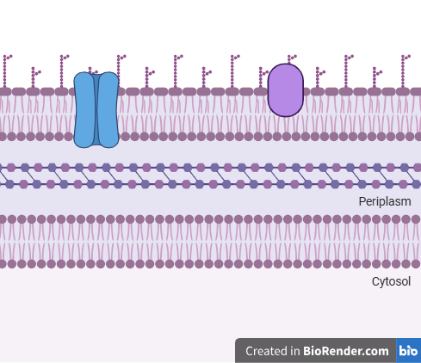
Construction of the Integrated Model
Establish transport reactions between the shared pool and different cell types:
From the shared pool of metabolites to the periplasm of a given pathogen
From the periplasm to the cytoplasm of the given pathogen
Introduce exchange reactions for extracellular metabolites from the enterocyte model on the apical and basal sides.
Introduce “Dilution” reactions for extracellular metabolites secreted only by the pathogens.
Cell Wall of Gram-Negative Bacteria

Slide 6
Objective Function
Objective functions in individual models:
ATP Maintenance in enterocytes
Biomass reactions in pathogens
Modified objective function in the integrated model:
Constrain the lower bound of the ATP Maintenance reaction in enterocytes to α times its maximum value (0 < α < 1)
Set the objective function equal to a sum of E. coli and V. cholerae biomass reactions.
This is known as a ‘Lexicographic Optimisation’ formulation:
Prioritise the host cell objective function over the biomass reactions of the pathogens
Polymicrobial pathology is not driven by host cell death, but by interference with signalling pathways.
Notes:
Since enterocytes do not proliferate, production of biomass
from precursors became insignificant. Instead, the capability of the model to perform specific metabolic tasks
such as fatty acid and carbohydrate metabolism, secretion of lactate from glucose uptake, among others, were
examined as a measure of the metabolic activity of enterocytes and to assess model quality
ETEC toxins manipulate cellular signaling pathways, including cAMP and cGMP, leading to increased chloride (Cl⁻) efflux via the Cystic Fibrosis Transmembrane Conductance Regulator (CFTR) and inhibition of Na⁺ uptake through the NHE3 Na⁺/H⁺ ion exchanger.

Slide 7
Results
Comparison between:
Case 1: Set the objective function equal to the ATP maintenance reaction in enterocytes
Case 2: Set the objective function equal to a sum of the biomass reactions of the two pathogens, and constrain the ATP maintenance reaction in enterocytes to a fraction of its maximum value.
The following reactions saw a substantial change in their fluxes:
Sharp decrease in the enterocyte ATP maintenance reaction
Increased flux through central carbon metabolism
Increased alanine secretion by ETEC, along with increased alanine uptake by V. cholerae
Increased serine secretion by VC, along with increased serine uptake by V. cholerae.

Slide 8
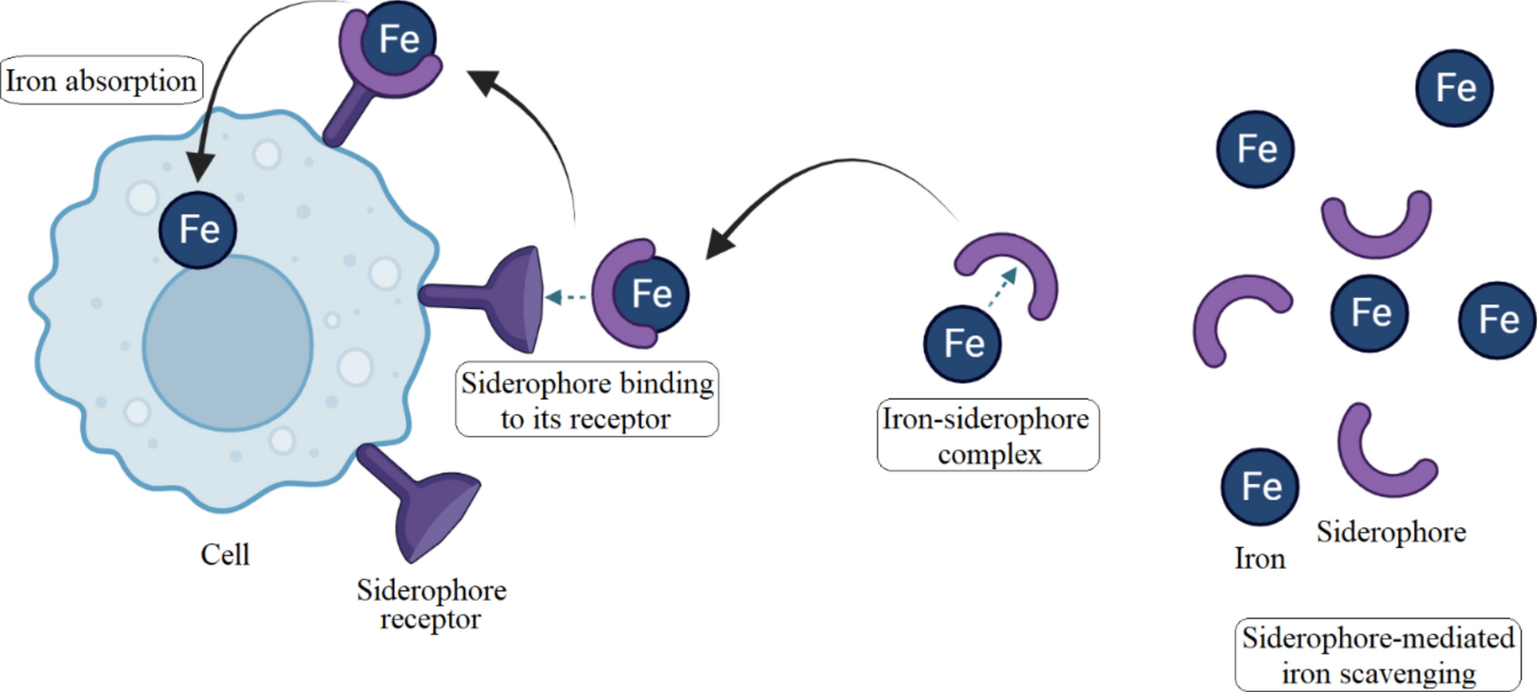
Results
Increased flux through the following reactions in V. cholerae:
Transport of Fe (III) from the shared pool of metabolites to the periplasm and the cytoplasm
Transport of Fe (II) from the cytoplasm to the extracellular milieu.
Role of Siderophores in Iron capture by bacteria, adapted from [3]

Slide 9
Results
V. cholerae biomass flux consistently reported to be lower than that of E. coli when the objective function was expressed as a weighted sum of the two biomass reactions.
This is contrary to previous reports from co-cultures of the two micro-organisms, where E. coli growth decreased in co-cultures as compared to mono-cultures.
V. cholerae toxins, secreted through the Type 6 Secretion System, known to be toxic for E. coli and S. typhirium, other enteric pathogens.
Potential involvement of non-metabolic factors in regulating the growth of individual pathogens as well as that of the host cell.

Slide 10
Challenges
Several published GEMs do not adhere to SBML guidelines (e.g., mass or change balance)
Full suite of interdependence tests could not be carried out due to missing information (e.g., missing gene labels or annotations).
Construction of a suitable objective function.
Flux bounds for exchange reactions of shared metabolites were imported from the enterocyte model. However, the flux bounds for newly introduced ‘transport’ and ‘dilution’ reactions were arbitrarily set.
Lack of omics data to constrain flux bounds in order to more accurately reflect the ‘ground truth’ – recent report of a triple-RNA seq. study [3]

Slide 11
Conclusion
An integrated model comprising of murine enterocytes, Enterotoxic E.coli and Vibrio cholerae was constructed.
Modifications such as the creation of a shared pool of metabolites, and the introduction of new transport and exchange reactions were implemented to ensure ‘cross-talk’ between the different cell types.
A ‘lexicographic’ objective function was devised to constrain the reaction fluxes.
The results of FBA were validated against known experimental trends and were also used to generate certain testable hypotheses.

Slide 12
References
Stacy, A., McNally, L., Darch, S. et al. The biogeography of polymicrobial infection. Nat Rev Microbiol 14, 93–105 (2016). https://doi.org/10.1038/nrmicro.2015.8
Tafazzoli, K., Ghavami, M. & Khosravi-Darani, K. Investigation of impact of siderophore and process variables on production of iron enriched Saccharomyces boulardii by Plackett–Burman design. Sci Rep 14, 22813 (2024). https://doi.org/10.1038/s41598-024-70467-7

